Slide 1

Magnolia grandiFLORA: digitally linking herbaria to support botanical research and education in Mississippi
Collaborators
Delta State University: Nina Baghai-Riding
Mississippi Museum of Natural Science: Heather Sullivan, Angel Rohnke, Libby Hartfield
Mississippi State University: Lisa Wallace, Gary Ervin
University of Mississippi: Lucile McCook
University of Southern Mississippi: Mac Alford
Institute for Botanical Exploration: Sidney McDaniel, Robert Stewart
Others: Charles Bryson, Lucas Majure

Slide 2
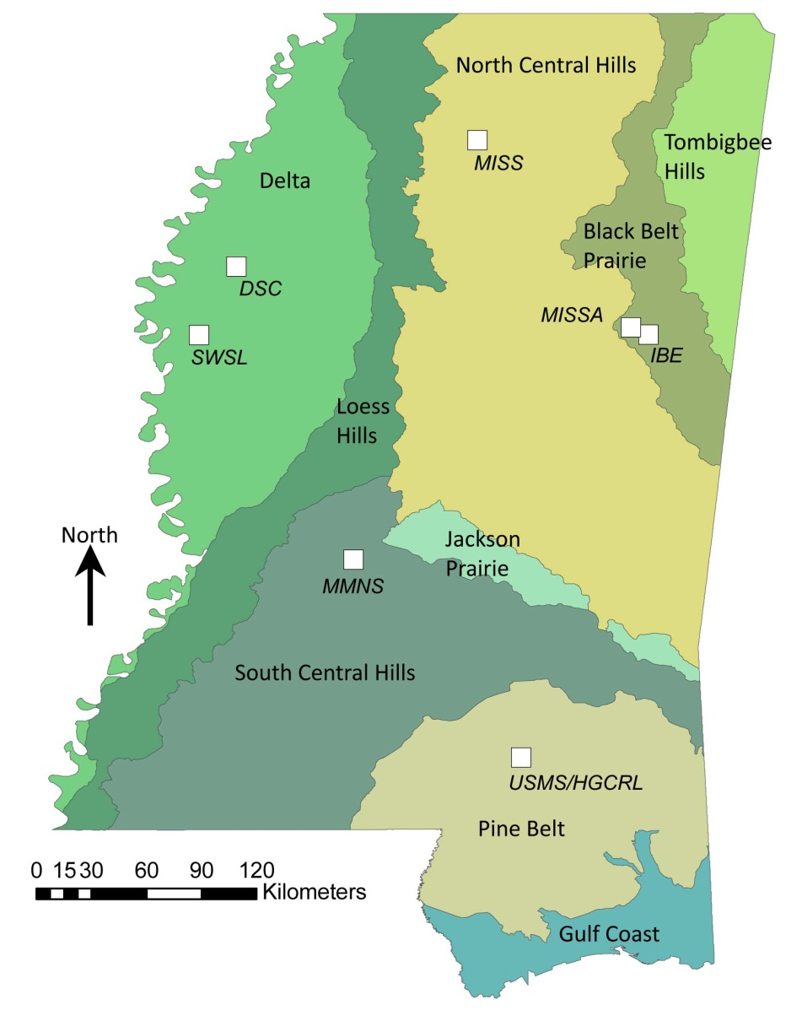
Mississippi’s Flora
3,120 species, 3,925 taxa – vascular plants
4 ESA listed species
MS ranks in the top 1/3 -1/2 of U.S. states in no. of plant species and genera and species per log area (Kartesz & Meacham 1999)
8th in numbers of plant families
MS spans 9 physiographic areas

Slide 3

8 Active Herbaria in Mississippi
Notes:
SWSL moved to MMNS on permanent loan earlier this year. Digitization of this collection is not included in the project because at the time we submitted the proposal it could not be included because it was a USDA collection.
Digitization of IBE will be handled by MSU.

Slide 4
Herbarium Collection Sizes in MS
Notes:
2010 figures

Slide 5
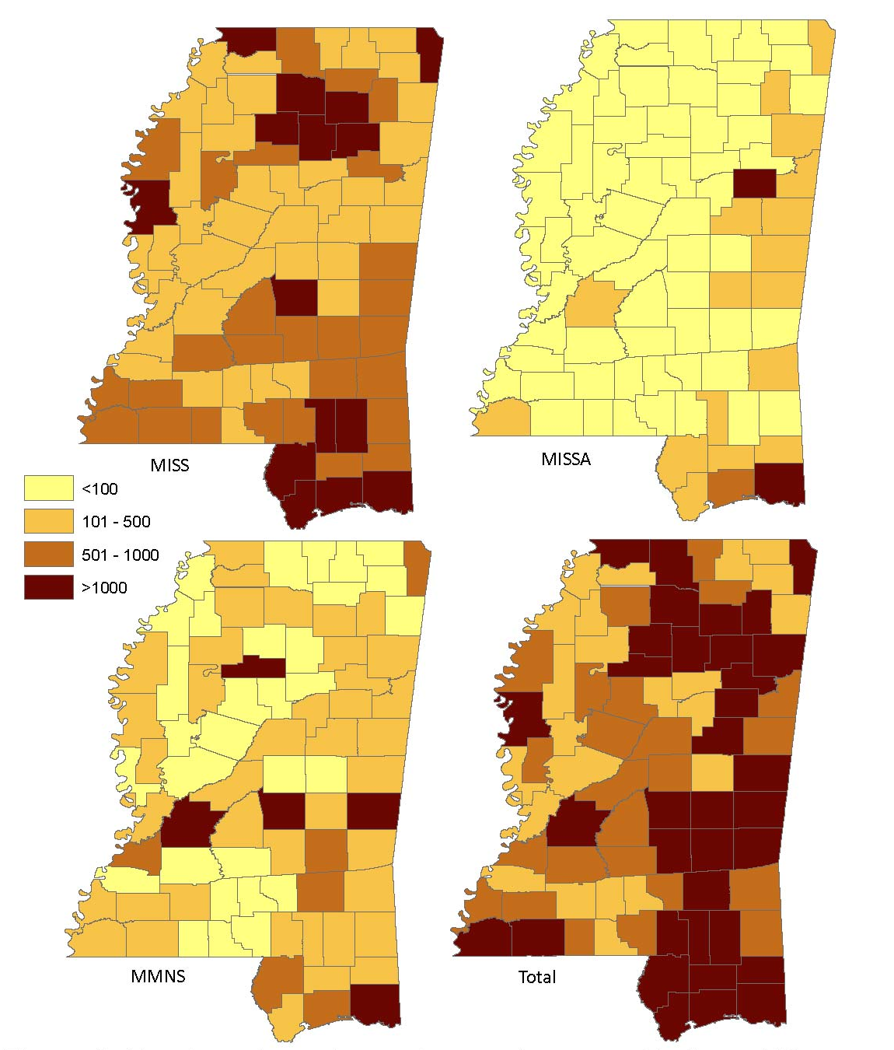
Specimens by County in 3 Collections
Notes:
Number of specimens by county present in three herbaria that have at least 50% of their specimen labels databased. The total number of specimens across these collections highlights regions of the state needing additional exploration. These maps were based on 2010 data.

Slide 6
Goals for Project Magnolia grandiFLORA
To image specimens and develop databases of label information for all active collections—MS &/or SE
To georeference specimens—by regional specialists
To integrate images with label and geospatial data in a virtual web-based framework
  —for 1) research & for 2) citizen scientists
To complete a checklist and atlas of the MS flora
To develop educational uses of the collections as they relate to the flora of MS
To train students in curation & information management & develop research projects that use the collections

Slide 7
Our Approach to Digitization
SilverBiology for imaging and development of the data portal
SPECIFY for database management*
GEOLocate for georeferencing
Undergraduate and graduate students involved
Data permanently housed at the MSU-
  High Performance Computing Collaboratory
All PI’s retain control of their data—have webpages specific to institution
Notes:
We may need to use another database format than Specify if conversion of existing databases doesn’t happen in a timely manner.
Alternatives and the advantages/disadvantages of each would be worth knowing more about.

Slide 8
Progress to Date
Funding is now in place at all institutions
Ordering equipment and getting SilverBiology software set up
State-wide meeting planned for later this fall

Slide 9
Educational Initiatives of
Project Magnolia grandiFLORA
MS Museum of Natural Science
Expand Project WILD and Project WET
Outreach Education
Higher education
General public

Slide 10
2010 Mississippi Science Framework
Grade levels | General topic area | Examples of specific learning targets
K – 2nd | Plant Anatomy | Understand characteristics, life cycles, environments of organisms.
1st – 3rd | Light, water, mineral nutrition | Identify basic needs of plants and animals.
3rd – 4th | Environmental adaptations | Compare characteristics of organisms in relation to their environments.
4th – 6th | Diversity, evolution, and natural selection | Compare and contrast the diversity across organisms in relation to adaptations to their environments.
6th – 8th | Food webs | Diagram the path of solar energy through food webs and explain how the organisms relate to each other.
9th – 12th | Taxonomy and plant structure and function | Differentiate the characteristics found in various plant divisions.

Slide 11
Outreach Education
MMNS reaches ~50,000 students annually
Programs available in 82 MS counties
“Green Power” – Identifying plants of MS, 2nd and 9th-12th grades
“Put on Your Boots” – Aquatic biology, 3rd-12th grades
“Here Today, Gone Tomorrow” – Endangered species, 2nd, 4th-12th grades

Slide 12
Project WILD and Project WET
Training for K-12 teachers in science & environmental issues
Tie plant diversity into existing training modules
IPAMS
Project Budburst
Project GLOBE (Global Learning and Observations to Benefit the Environment)

Slide 13
Higher Education
Used in courses - Plant Taxonomy/Systematics, Conservation Biology, Environmental Biology, Aquatic Botany
Graduate research assistantships - students actively using the collections in research projects
Undergraduate research:
  Quantifying species distributions
  Interactive Keys
  Choctaw and Chickasaw native plant garden – U. of MS Field Station
Notes:
Mac has been working on some interactive keys. The website for these is http://www.usm.edu/herbarium/resources.htm, but he has not updated it recently.

Slide 14
General Public
“Public” website for the project

Slide 16
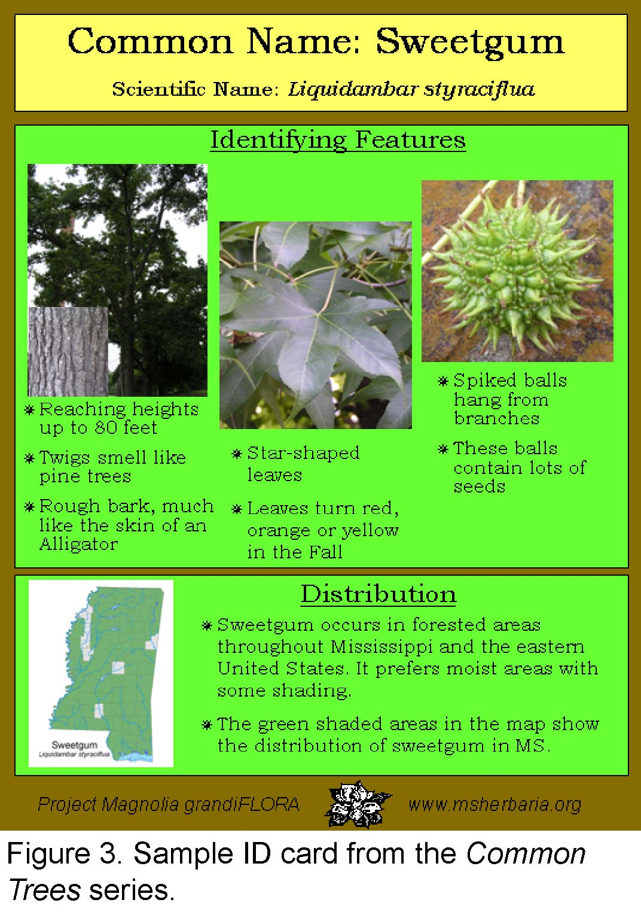
ID Cards
Common trees of MS
Regional diversity
Carnivorous plants
Invasive plants
Backyard beauty

